Slide 1
LBG, MLP
2019-11-21

Slide 2
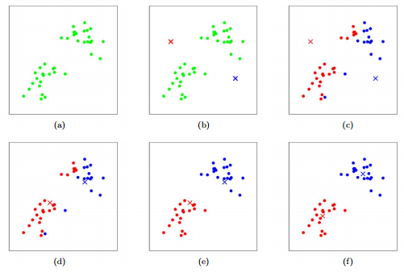
clustering
We can easily divide this data into two parts.
Machine can learn it?

Slide 3
K-means clustering
1. fix k, and set k initial (random) centroids

Slide 4
K-means clustering
2. assign every point to the closest centroid(E step)

Slide 5
K-means clustering
3. compute new centroids of points assigned to same centroid(M step)

Slide 6
K-means clustering
4. go back to 2. and repeat!

Slide 7

K-means clustering
Stopping criterion
$D=\sum_{X_{i} assigned to y_{j_{i}} }{{\left|X_{i}−y_{j_{i}}\right|}^{2}}$
D’ – D <e or max iteration.

Slide 8
K-means clustering
Q. how to know good k?
Q. how to set initial points?

Slide 9
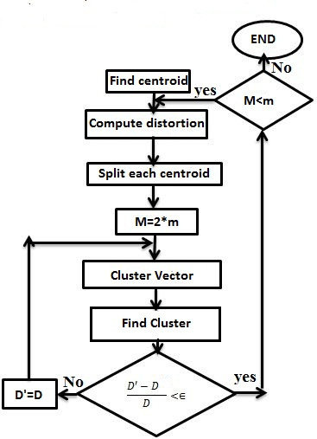
LBG algorithm
Flow chart

Slide 10
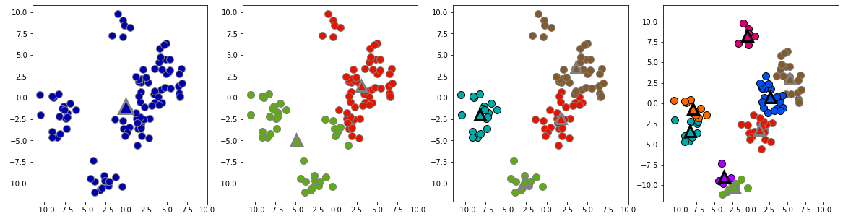
LBG algorithm
1. starts from k=1 : even monkey can do ☺

Slide 11
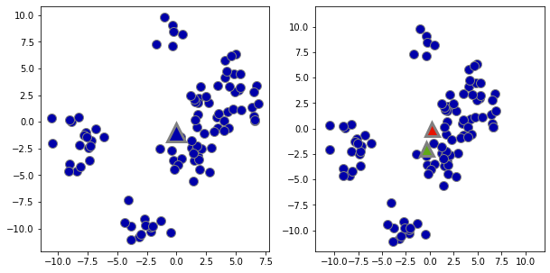
LBG algorithm
2. divide each centroid into two perturbed centroids (scale : 1% of dataset scale? Whatever you want small enough)

Slide 12
LBG algorithm
3. run k means with k<- 2*k!

Slide 13
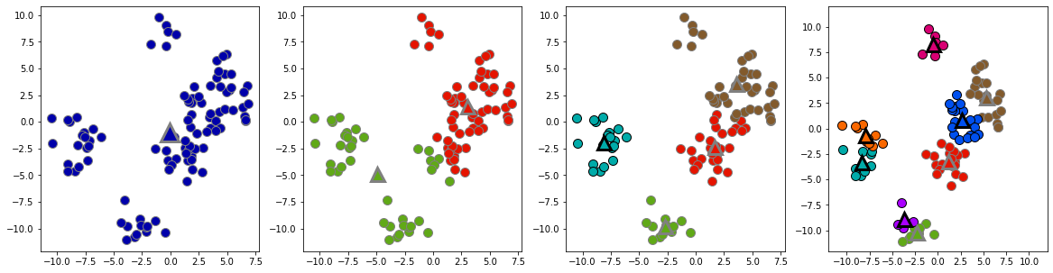
LBG algorithm
4. go back to 2 if D is not changed enough & k<N : maximum #of clusters

Slide 14
LBG algorithm
5. STOP if D is not changed enough & k>=N :

Slide 15
LBG algorithm
It automatically choses initial points & cluster number!
Try creating your own clustering

Slide 16
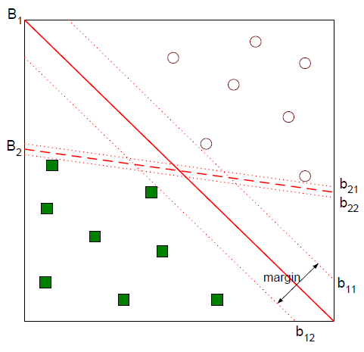
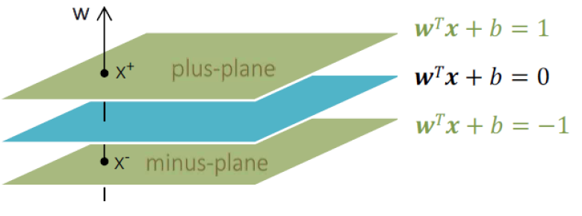
SVM

Slide 17
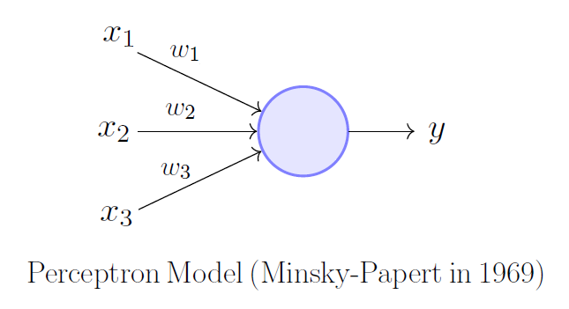
Perceptron
Consider such linear function
y>b -> class 0, y<b : class 1

Slide 18
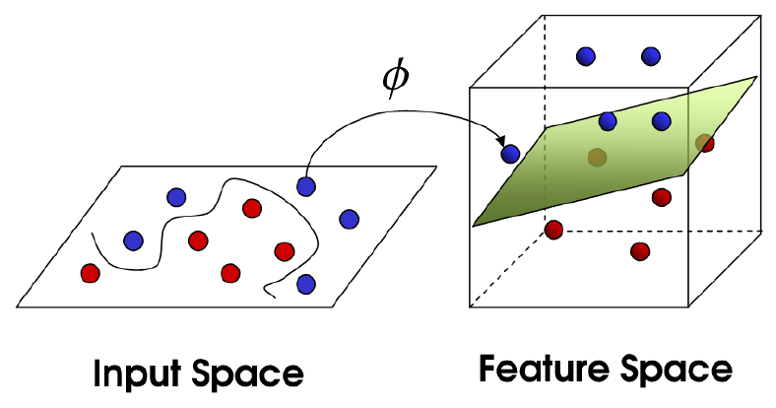
Kernel trick
Embed dataset into feature space(kernel) and apply SVM!

Slide 19
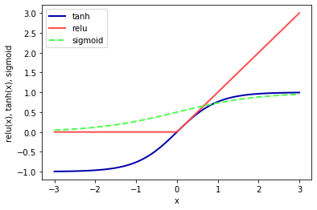
Activation function
Any non linear function!
‘Differentiable’
Monotonicity
Easy to compute
Etcs.
Ex) ReLu, sigmoid, tanh, …

Slide 20


Activation function
$$f$$
$$b$$

Slide 21
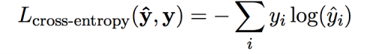
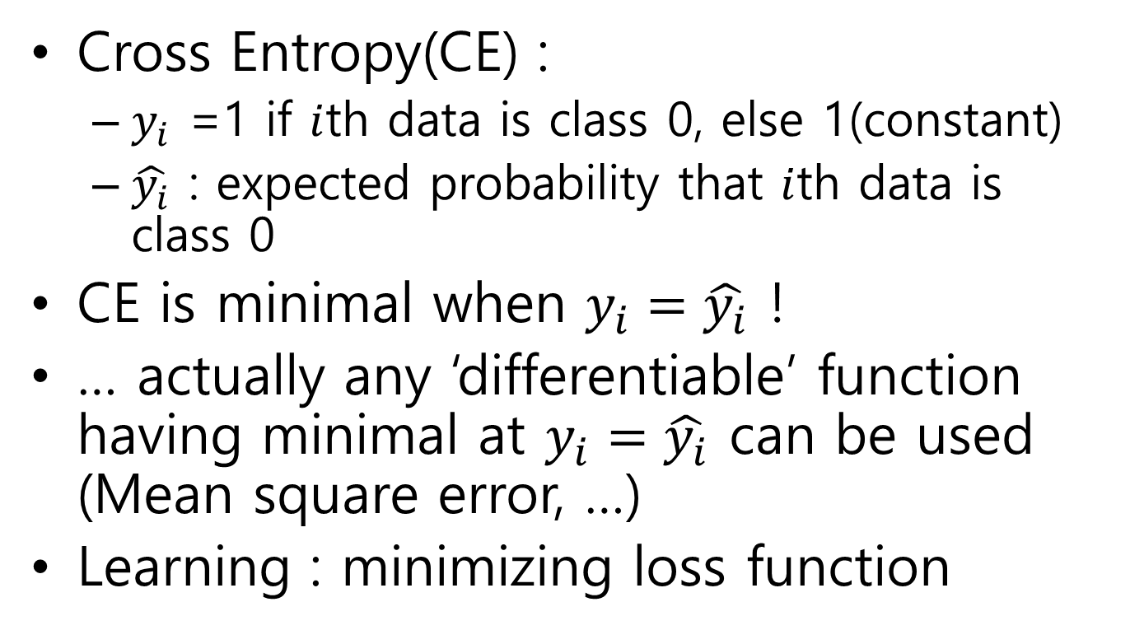
Loss function
Cross Entropy(CE) :
$y_{i}$ =1 if $i$th data is class 0, else 1(constant)
$\hat{y_{i}}$ : expected probability that $i$th data is class 0
CE is minimal when $y_{i}=\hat{y_{i}}$ !
… actually any ‘differentiable’ function having minimal at $y_{i}=\hat{y_{i}}$ can be used (Mean square error, …)
Learning : minimizing loss function

Slide 22
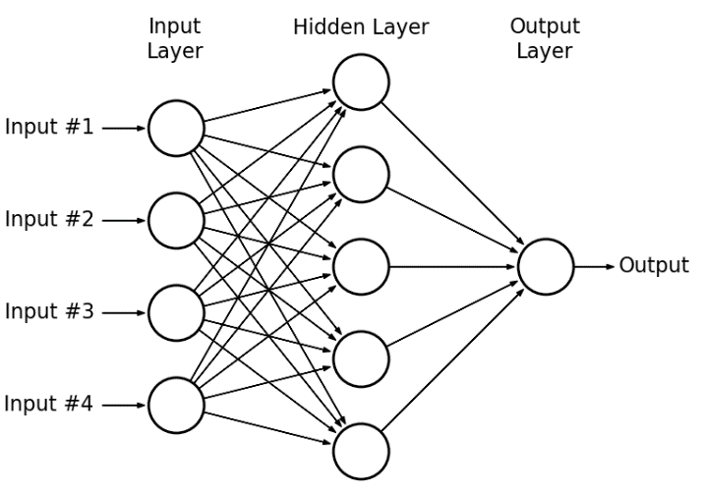
Multi Layer Perceptron

Slide 23
Multi Layer Perceptron
Universal approximation theorem : theoretically, 1 hidden layer is enough
…but ‘deeper’ model is more powerful in practice!
-> deep learning

Slide 24
References
https://www.researchgate.net/figure/LBG-algorithm-1-Plan-a-1-vector-codebook-This-is-the-centroid-of-the-whole-arrangement_fig4_304785827
https://missinglink.ai/guides/neural-network-concepts/perceptrons-and-multi-layer-perceptrons-the-artificial-neuron-at-the-core-of-deep-learning/
https://www.scss.tcd.ie/~koidlk/cs4062/Loss-Functions.pdf
… and see out textbooks & references of textbooks(The elements of statistical learning, Deep Learning, etcs)

